Slide 1
Nature: Inspiration for products and processes

Slide 4
Nature as an inspiration for product design

Slide 5
Biomimicry
Nature as an inspiration for solving problems and developing new products

Slide 6
Nature and business lifecycle

Slide 7
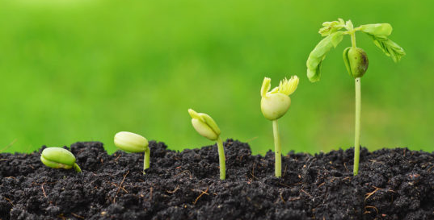
Stages in the Business Lifecycle
Creation: ‘planting’ and ‘growth’ of an idea; biomimicry where successful elements from nature inspire businesses to be created;
Survival: competition is a selection process, it selects the products that best meet customer needs and offer value for money- often related to
Adaption: how can a business grow and/or respond to changes in the external environment
Extinction: not all businesses will survive, just as species become extinct. Some will not get through the selection process

Slide 8
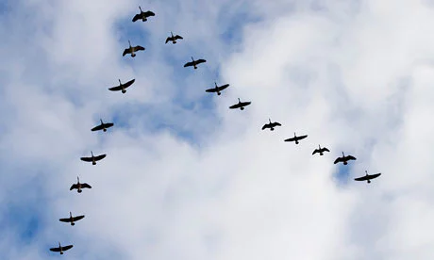
Responses to Change
Adaptation
-supermarkets
Extinction
-firms that fail to adapt often become extinct
Notes:
“Adaptation is enhanced when the organisation (individuals and communities of stakeholders) finds it easier to let go of the old and embrace the new. For example, geese when they fly in a V-formation rotate leadership to ensure that at any given point in the journey, it is always fit for purpose”
Current examples are supermarkets, who managed to adapt to changes in transport by creating out of town retail parks, but have found it harder to adapt to the new consumer pattern of buying smaller amounts more frequently. Tesco has had difficulties adapting from the first model to the second and overexpanded by both trying to build too many large supermarkets and buying up extra types of businesses, like restaurants, which it planned to add into these large supermarket

Slide 9
Nature and business practice

Slide 10
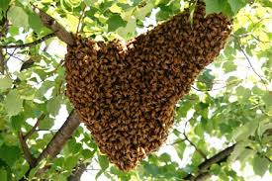
Implications for Business
1. Compose the decision making group of individuals with shared interests and mutual respect
2. Allow open inquiry and consider diverse solutions to the problem
3. Aggregate the group’s knowledge through debate
4. Use quorum responses for cohesion, accuracy and speed
Notes:
The biologist Thomas Sweely who studied decision making in bees also drew some lessons for modern business and politics
1. Compose the decision making group of individuals with shared interests and mutual respect
-remind people that the overarching goal is to make decisions that benefit everyone
-use a moderator at meetings, who people address their comments to. This can avoid things becoming too personal
2. Allow open inquiry
-the honeybees make their decision without the Queen serving as a leader. This can be difficult to exactly replicate in business but one option is for the head of the business to avoid expressing a strong preference for any of the ideas under debate. This avoids the issue of ‘trying to please the leader’ . If the issue is particularly tricky, allow people some time to consider it before a meeting. In smaller meetings, ask everyone present if they have something to add.
In larger meetings introduce rules so that no one individual can dominate discussion. For example at town meetings in America ‘no one may speak more than twice on a particular issue until everyone who wants to speak on the issue has had an opportunity to do so once’
Aggregate the group’s knowledge through debate – each scout bee ‘decides whether to advertise and, if so, how strongly, based on her own independent evaluation of the site. No scout bee… will blindly follow another scout’s opinion by dancing for a site that she has not inspected. This avoids situations such as those occurred in the ‘stock market bubble in the late 1990s, when investors bought stocks in telecommunication and technology companies based on watching what others were buying – the ‘conventional wisdom’ –rather than on checking carefully for themselves the fundamentals of those companies’
Use quorum responses for cohesion, accuracy and speed – consider taking secret ballots during a decision making process/meeting to establish how far a group is towards consensus. ‘If a poll reveals that we are far from unanimity, then we all know that further careful debate is needed for everyone to become of one mind. But if a poll reveals that we are close to agreement, the few people supporting the minority decision usually will realize that a collective decision has essentially been reached, that prolonging debate is pointless and that it is best to switch to the majority consensus to build the needed consensus’

Slide 11
Nature as a product

Slide 12
Wind Power
Business opportunity: coal and petroleum not available all locations
Solutions
1.1850s windmills used in central US to power drawing of water for steam locomotives of transcontinental railways
2.1920s creation of more efficient 3 blade propellers to power rural farms that were off-grid and far from other fuel sources
-Inspiration was airplane propellers and experiments with WWI surplus army equipment
-Capital for Jacobs Wind Energy came from local farms
-Lit-up farm at night attracted customers
-by 1950s 50,000 wind plants built but company went bankrupt as more farms were added to grid

Slide 13
Solar Power
Business opportunity: coal and petroleum not available all locations; space exploration
Solution
-1890s use sun in locations with lots of sun (e.g. California) but no oil
-1892 Aubrey Eneas founded the Solar Motor Company of Boston, creates solar powered engines for agricultural irrigation
-1907 Frank Shuman creates improved engine design; small pilot to attract investors
-1911 Shuman founded Sun Power Company and creates solar powered irrigation plant in Egypt (lot of sun, no coal)
-1914 WWI forces staff to leave Egypt; plant broken up for parts
-1918 Shuman dies; price of fossil fuels drops
-1950s interest from US space programme to use solar power for its satellites; invention of photovoltaic cell
-However until recently costs were too high to put technology to wider use, so few new entrants to the field

Slide 14
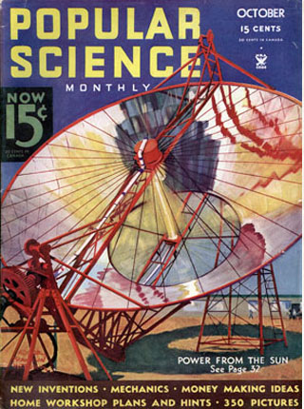
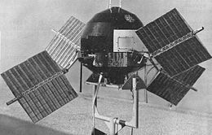
Eneas’s Solar Collector and Photovoltaic Cells on a Satellite

Slide 15
Architecture
Problem: How to make buildings that were energy efficient
Solutions
Frank Lloyd Wright: 1943 Solar Hemicycle Houses which make the greatest use of the sun’s path so house well-lit in day
Victor and Aldar Olgyay 1950s-1970s: ‘each climate region demanded different forms’; importance of thinking about the thermal effects of different materials, wind direction etc
Hassan Fathy 1930s-1940s: use of traditional materials and techniques https://www.wmf.org/project/new-gourna-village

Slide 16
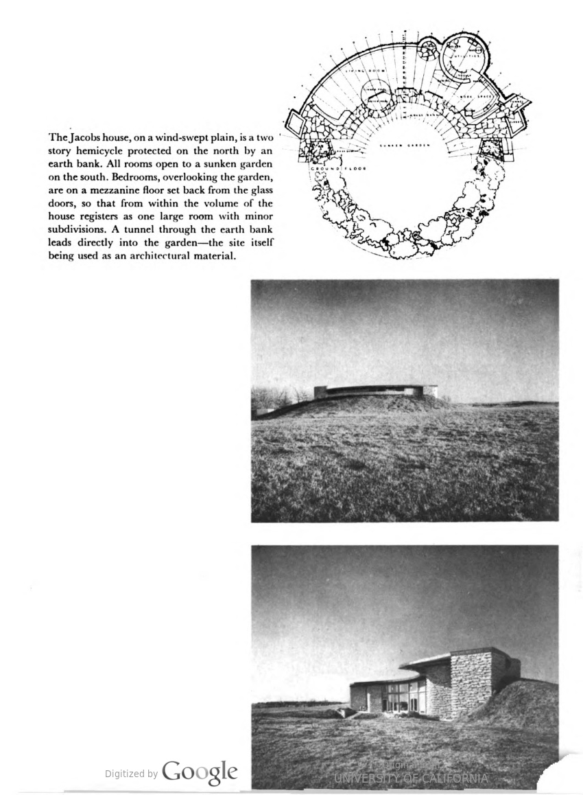
The Second Jacobs House, Wisconsin
Source: Built in USA: post-war architecture, edited by Henry-Russell Hitchcock and Arthur Drexler (1952)

Slide 17
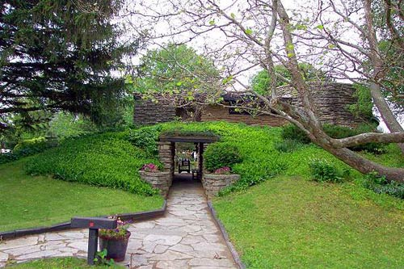

Slide 18
Nature and business processes

Slide 19
Circular Economy
Two cycles
-Biological: food and natural materials (like cotton) are returned to nature through processes such as ‘composting and anaerobic digestion’ and contribute to natural regeneration
-Technical: products, components and materials (such as phones) are reused, repaired, remanufactured (a part is ‘put back’ in another product) or recycled
Overview of circular economy

Slide 20
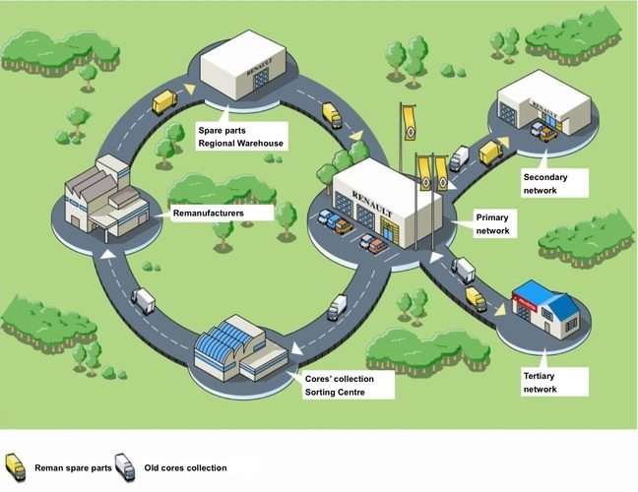
Technical Cycle: Circular Process in Cars
Notes:
Renault’s Choisy-le-Roi plant
Remanufactured parts taken from discarded cars and are used to repair vehicles currently in use rather.
The advantage of this is that the remanufactured part is older and going into an older car (which has about the same lifecycle) rather than a new product being put into an older car
Sometimes they are the only source for parts that have been discountinued
For the customer, a remanufactured part is 30-50% cheaper than a new alternative. This can have a wider benefit, as it provides an incentive to repair cars which otherwise might have been discarded because the cost of the repair was more than the value of the car
The savings from the production of a remanufactured part compared to a new part are as follows:
80% less energy 88% less water 92% less chemical products 70% less waster production
In terms of raw materials, the Choisy-de-Roi factory does not send any waste to landfill:
43% of the carcasses are re-usable 48% are recycled in the company’s foundries to produce new parts The remaining 9% is vaporised in treatment centres meaning the entire process is waste-free.

Slide 21
Biological Cycle: Toast Ale and Babylone
44% of all bread produced in the UK is thrown away – about half by sandwich factories, bakers and supermarkets
Potential alternative uses for the bread
-animal feed (Tesco and Sainsburys use this)
-composting (Waitrose and Morrisons)
Babylone established c. 2015 in Brussels Toast Ale established in 2015 in London
Both use waste bread from delis, bakeries etc and use it to replace around 1/3rd of the malted barley used in brewing
Toast Ale a social enterprise, 100% of profits go to a charity focused on reducing food waste. Recipe is shared to encourage other brewers to join the movement
Notes:
As

Slide 22
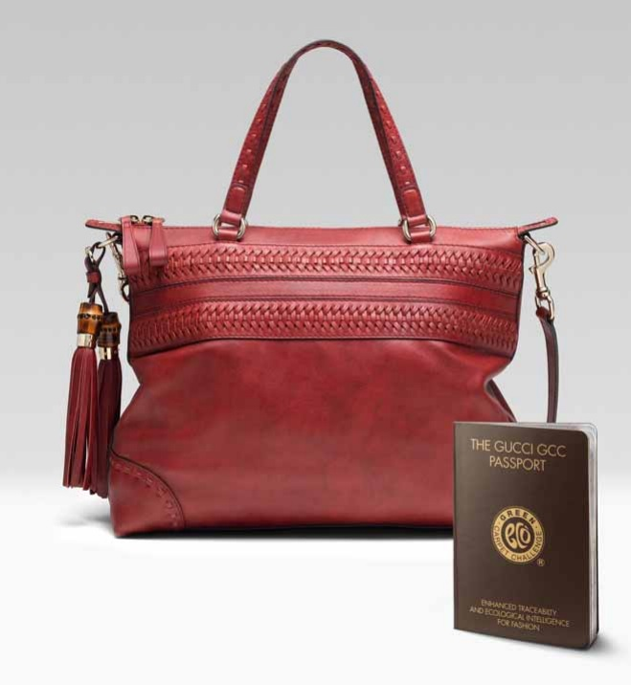
Limiting Impact of Supply Chains
The grazing of cows for leather has contributed to deforestation of the Amazon, while the dyeing of leather has polluted water
Deforestation destroys habitats and biodiversity and contributes to global warming
Gucci’s range of luxury anti deforestation leather bags was produced in conjunction with the Rainforest Alliance, the Green Carpet Challenge and an American wildlife organisation
Each bag comes with a passport (showing full traceability of materials ) and is dyed using vegetable rather than chemical dyes

Slide 23
The Entrepreneurial Management Model
Entrepreneurial working
Opportunity focus:
Natural resources
Necessity (lack of resources)
Rapid innovation:
Mixture of formal training (solar power; architecture)) and informal experiments (windpower
Creating customer appeal
Retaining core identity of brand (Gucci)
Demonstrating use of product (solar and wind power)
Challenge the orthodox
Reuse of waste materials
Managerial working
Strategic focus:
Need to crate a company to scale-up ; initial entrepreneur needs to delegate/work in a team; don’t progress in leaps (failure of Fathy)
Managing resources: Dealing with scarcity and surplus
Managing relationships:
With government and with end users (ie teaching new skills)
Systematic value management:
Can be difficult as costs to scale businesses large.
Using government resources
Using waste resources ie WWI army surplus
Creating new value
Finding new ways of using existing natural resources
Recognising opportunities provided by scarcity of resources in particular locations
Reuse of waste materials

Slide 24
Further reading
F. Boons, Creating Ecological Value: An Evolutionary Approach to Business Strategies and the Natural Environment (2009, Cheltenham)
G. Jones, Profits and Sustainability: A History of Green Entrepreneurship (Oxford, 2017)
C. Meisner Rosen and C. C. Sellers, ‘The nature of the firm: Towards an ecocultural history of business: [Introduction]’, Business History Review, 73 (4), (1999), pp. 577-600.

